Slide 1
Lower Bound Theory
Lower Bound Theory Concept is based upon the calculation of minimum time that is required to execute an algorithm is known as a lower bound theory or Base Bound Theory.
Lower Bound Theory uses a number of methods/techniques to find out the lower bound.
Concept/Aim: The main aim is to calculate a minimum number of comparisons required to execute an algorithm.

Slide 2
Techniques:
The techniques which are used by lower Bound Theory are:
Comparisons Trees.
Oracle and adversary argument
State Space Method

Slide 3
BIN PACKING
Next-fit is an algorithm for bin packing. Its input is a list of items of different sizes. Its output is a packing - a partition of the items into bins of fixed capacity, such that the sum of sizes of items in each bin is at most the capacity.

Slide 4
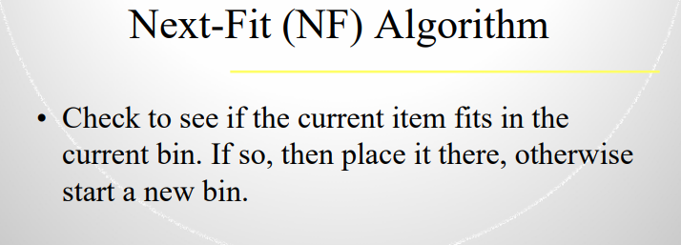

Slide 5
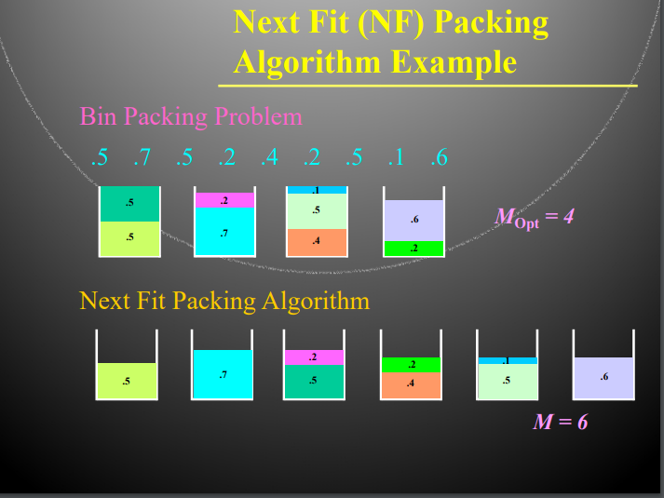

Slide 6
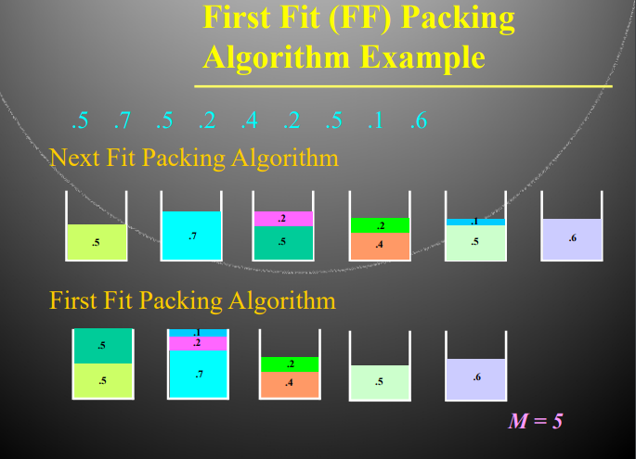

Slide 7
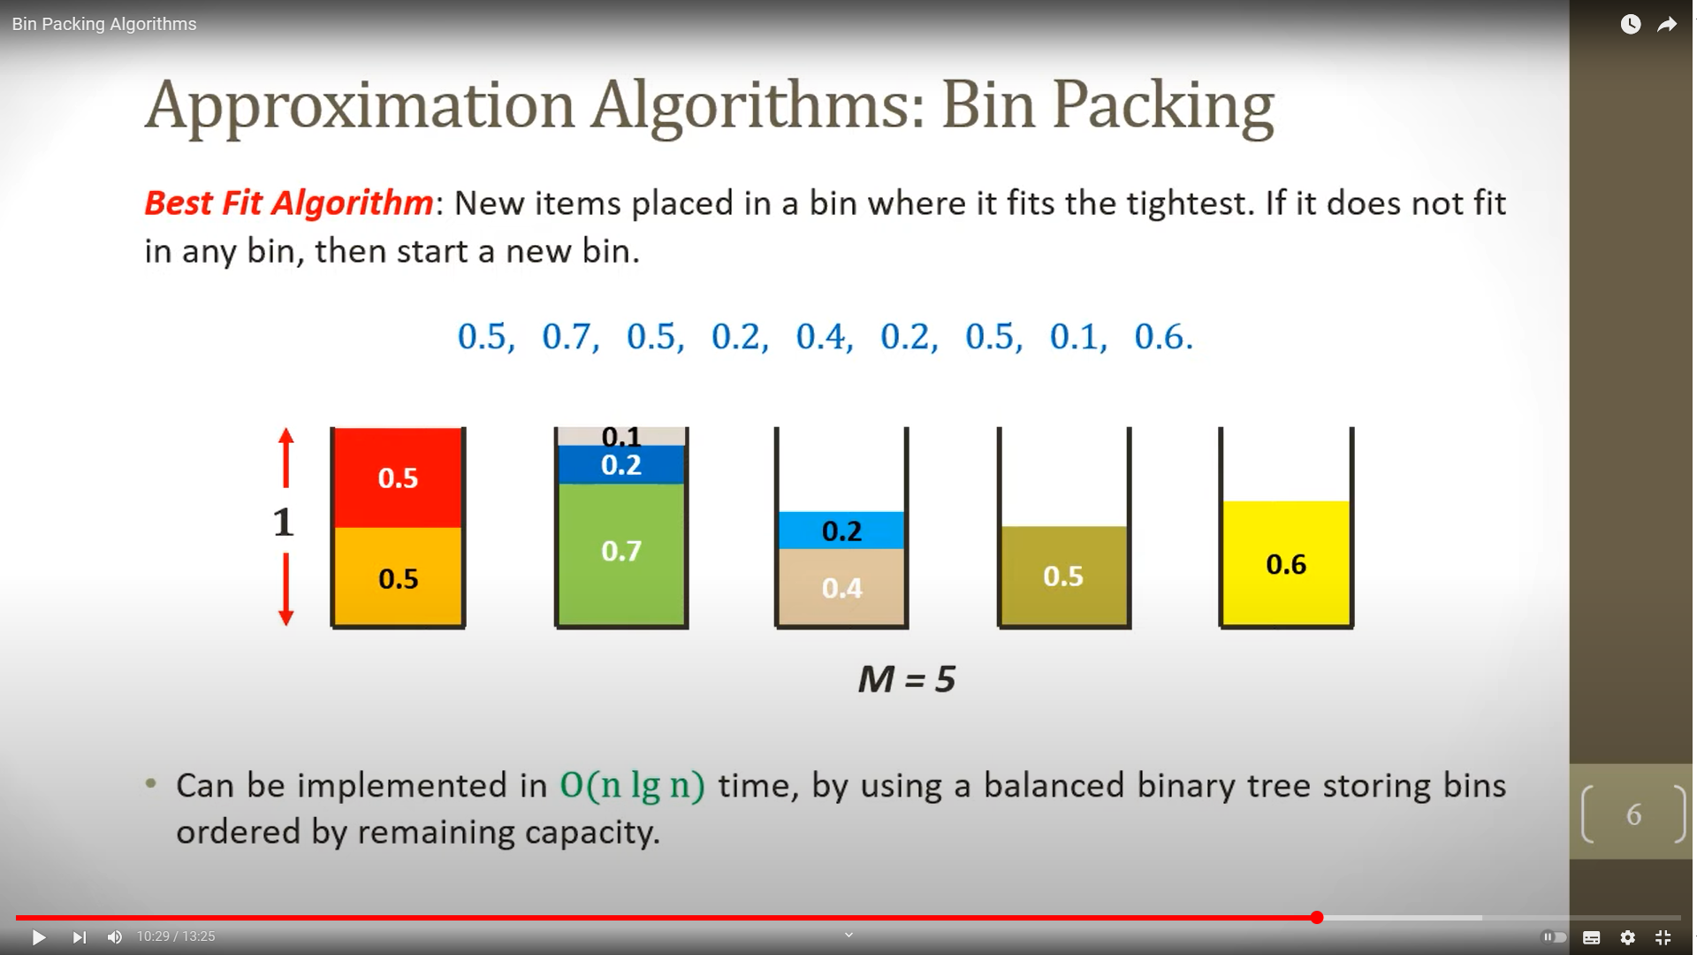

Slide 8
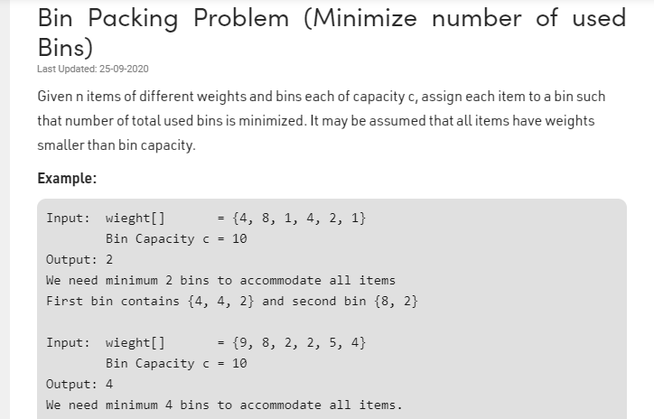

Slide 9
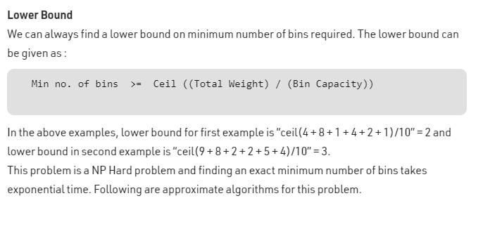

Slide 10
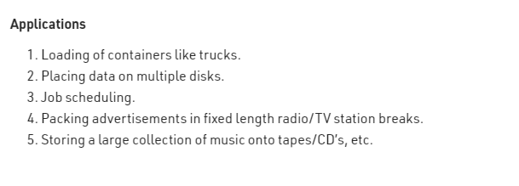

Slide 11
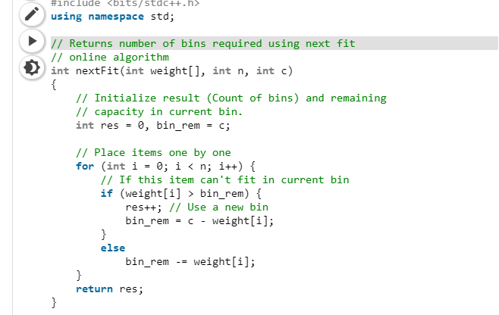

Slide 12
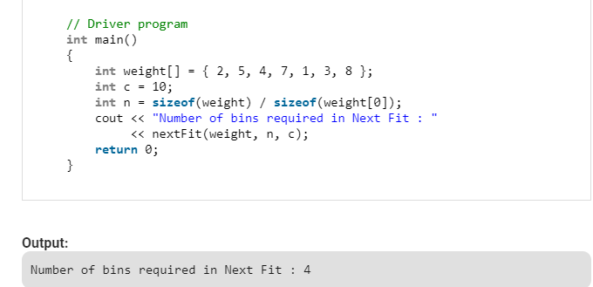

Slide 13
Bin packing problem comes under
Greedy strategy
Divide and conquer
Dynamic programming
None of these

